Slide 1
Mitchell Grafton
Ceramic artist

Slide 2
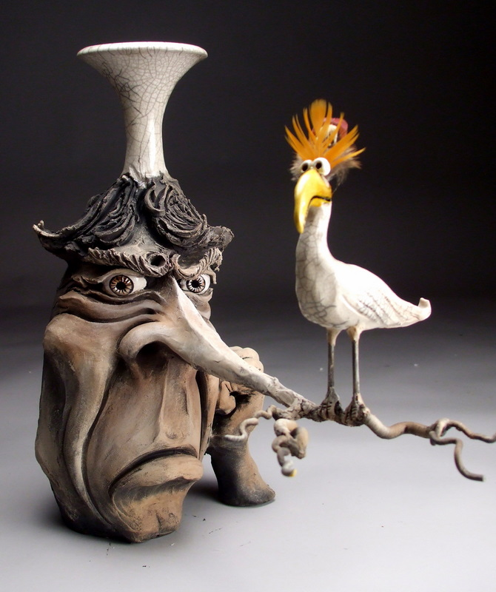

Slide 3
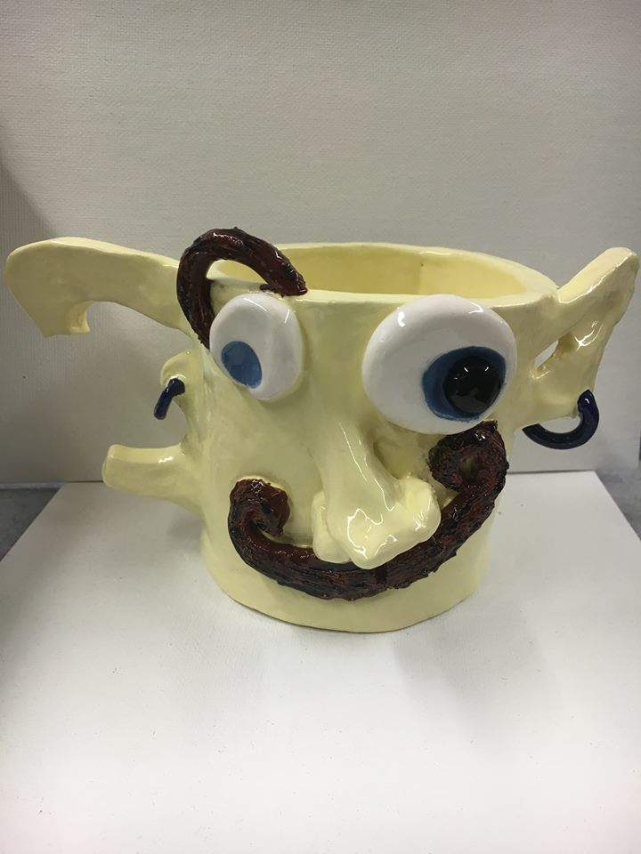
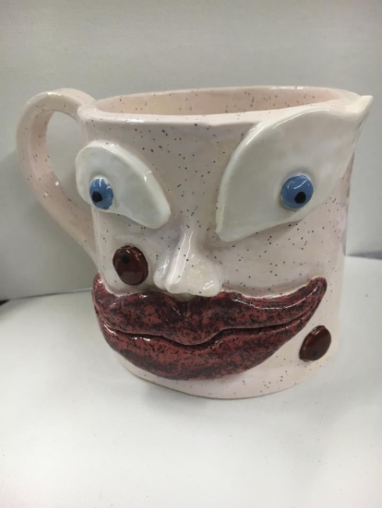
Mugshot Monday!
Introducing the
MUGLYS

Slide 4
Your project requirements
Create a food safe mug (even glaze application, we will discuss this part when we get there)
Walls of mug should be even. This is all about your craftsmanship.
Slip and score done correctly (no parts falling off or unsightly, unintentional marks where objects where attached)
Mug must have a handle. The handle can be traditional or creative (maybe part of your mugs features?)

Slide 5
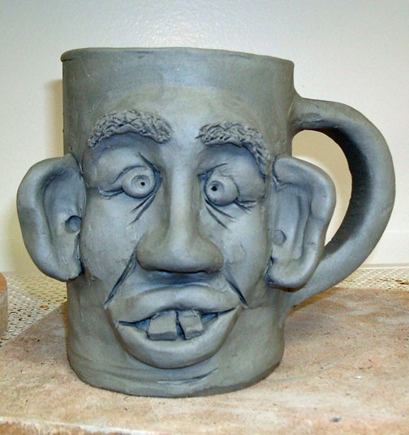
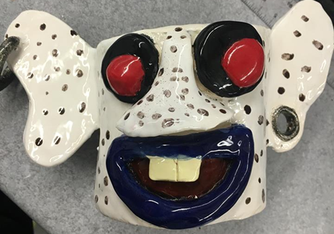
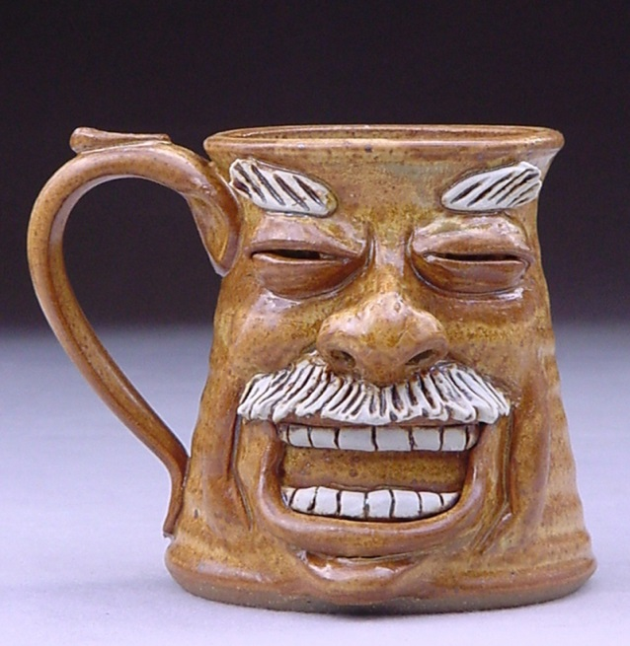
Requirements continued
Mug must incorporate a minimum of 2 textures. Most of you will most likely have a smooth mug so you will need one more.
Be creative with this!

Slide 6
Contest?????
Working with clay can be challenging, messy, but most of all fun!
To make this even more interesting….
There will be contests held for the following categories: -most interesting and creative glaze application. – most creative handle – most and best texture applications – best life story of your Mugly – And the most beautiful Mugly.

Slide 7
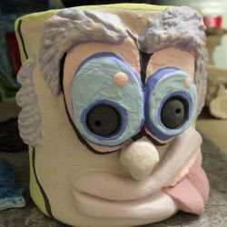
Day one
Read small packet on introduction to clay and the artist who inspired our project.
Fill out packet including a small sketch of what your Mugly might look like. (feel free to add color so I can really get a idea of how to help you best achieve your Mugly)

